Slide 1


AI- Text Classification
Baseline, Pre-trained model
MASTER DISc - M1
2021-2022
Yao SINAN
yao.sinan@cri-paris.org
CC BY-NC 4.0

Slide 2
INTRODUCTION
Context : Fake news about covid 19 were spreading across the world as the virus itself. To help fighting against this fact, 3 students at Cornell University; Yichuan Li, Bohan Jiang, Kai Shu, Huan Liu propose fake news detection dataset using scraping technologies.
Overall, the dataset, a json format consists of 16274 records and 928 columns reduced to 3 981 pieces of fake news and 7192 trustworthy pieces from 6 different languages setting up from English, Spanish, Portuguese, Hindi, French and Italian.
Note : They also provided, others dataset, you can use to build a network to visualize relations between profiles and tweets.
What is required from me: Build a baseline model and use Pre-trained model .
how will I do what is required: prepare the json and flatten it, build the model and discuss the results.

Slide 3
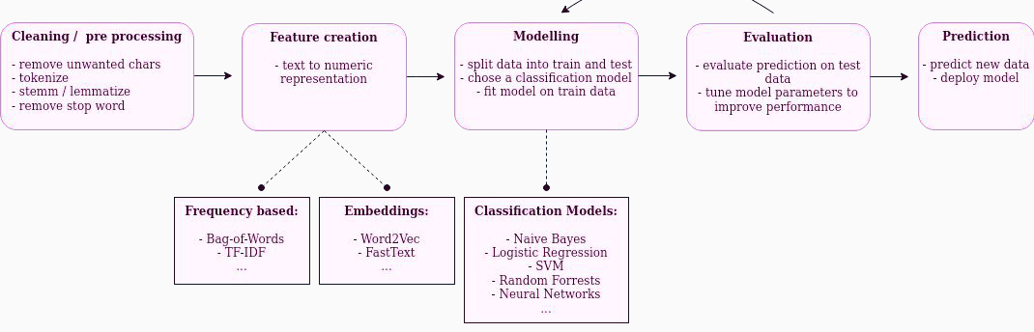
ROADMAP – JOURNEY TO TEXT CLASSIFICATION
Notes:
The workflow of my presentation.

Slide 4
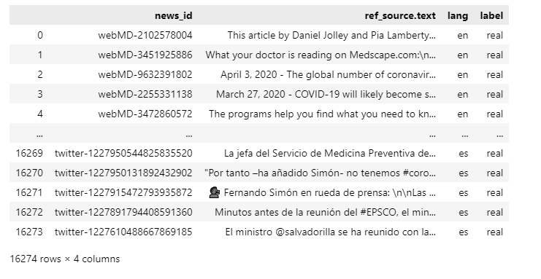
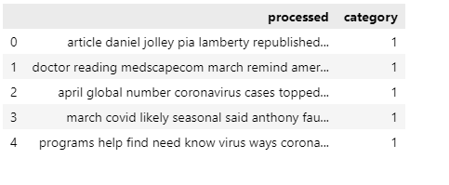
1 – Dataset architecture
Type of dataset : Multilingual dataset: many languages in the dataset
Number of rows and columns : 11784 and 2 columns
Overall 4171 missing values : 23% of the dataset
these missing values are based on np.nan, either empty text, that to say len() <= 5
Label encoding - real : 1 fake :0
Notes:
A project is a toTO-DO LIST containing tasks and responsibilities.
PM is an approach to structure that.

Slide 5
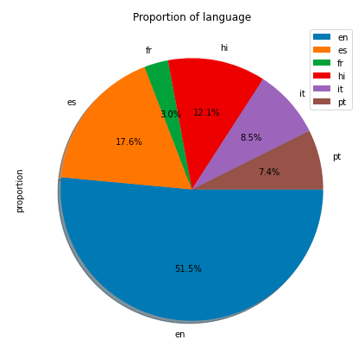
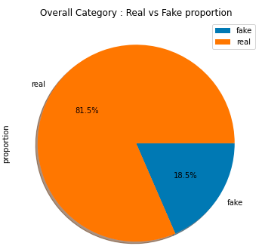
2- EDA
Please find some visuals of proportion below :

Slide 6
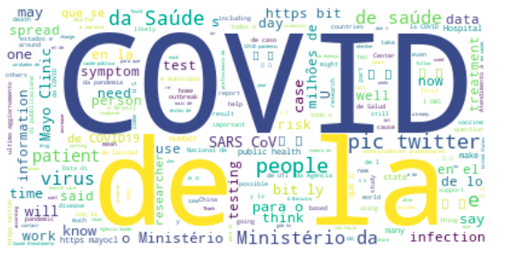

2- EDA – Before processing
Real
Fake

Slide 7

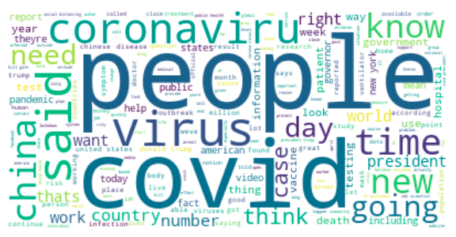
2- EDA - After processing
Real
Fake

Slide 8
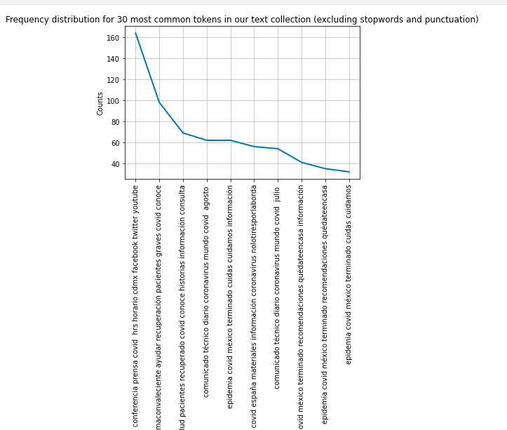
2- EDA - After processing
Frequency distribution of 30 most important words

Slide 9
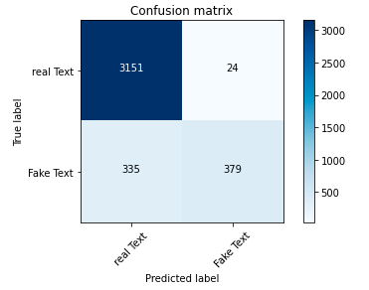
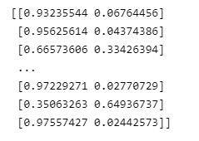
3- Model Logistic Regression
Cross validation : cv = 5
Conversion to sparse matrix : tf-idf
Number of candidates models : 6
Accuracy : 90.7
Confusion matrix and Probabilities :

Slide 10
4-Deep Learning – Corpus with bert

Slide 11
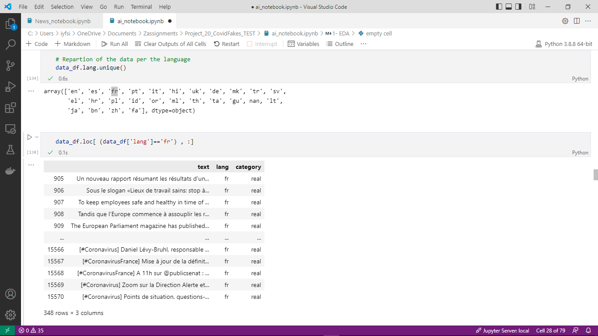
5 – BIAS and REFLEXION?
1. the proportion of missing text around 23%
2. the proportion of mis-assigning language to text/content :
assign French to English content
assign Ukrainian to English content
3- Removing these other languages based on the fact they mentions 6 languages And for example Japan has two text/content
4- 62 content/text without language tag :
it was NaN, null values and is a mixed of different language
: Brazilian, English
5- Stemming and Lemmatization not possible
Because of many languages we cannot stem or lem
Available stemming for only 4 European languages : http://snowball.tartarus.org/texts/stemmersoverview.html
I have read across, no possible combinations of or USE.
Notes:
A project is a toTO-DO LIST containing tasks and responsibilities.
PM is an approach to structure that.

Slide 12
6 – References
Exploration of real and fakes news, identifying patterns in both
By Varsha P, David Smerkous, Ruolin Chen, Mong-Phi Le
https://medium.com/@palepvar/fake-news-real-consequences-d7ff416e505e
LIST OF STOPWORDS LINK TO ARTICLES : https://towardsdatascience.com/text-pre-processing-stop-words-removal-using-different-libraries-f20bac19929a
https://towardsdatascience.com/text-pre-processing-stop-words-removal-using-different-libraries-f20bac19929a
Text classification
https://machinelearningmastery.com/crash-course-convolutional-neural-networks/
https://machinelearningmastery.com/crash-course-recurrent-neural-networks-deep-learning/
State-of-the-art Multilingual Lemmatization
https://towardsdatascience.com/state-of-the-art-multilingual-lemmatization-f303e8ff1a8
Notes:
A project is a toTO-DO LIST containing tasks and responsibilities.
PM is an approach to structure that.

